Slide 1
Travelliing salesman
Simon Have, Jesper Bækdahl, VGIS 822

Slide 2

Traveling Salesman Problem

Slide 3
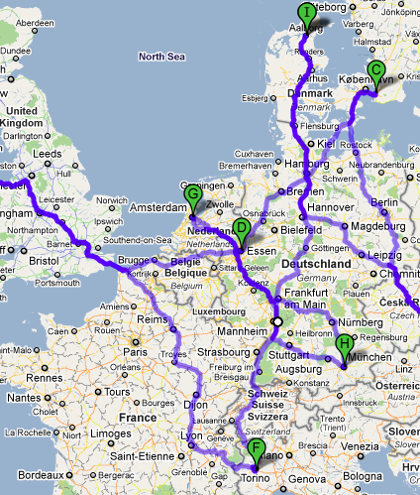
Problem
Find shortest path between cities given their pairwise distance
Most intensive problems studied in optimization

Slide 4
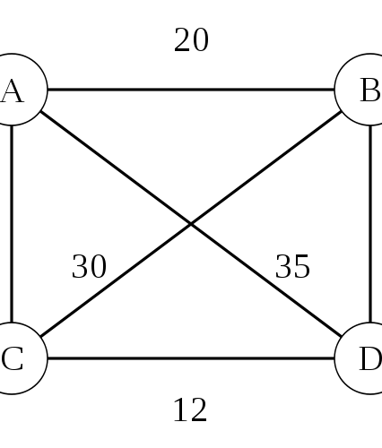
Graph problem
Cities = vertices
Edges = distances between cities
Equivalent: Find a Hamiltonian cycle with least total distance
Notes:
Hamiltonian cycle visits each vertex exactly once and returns to start vertex

Slide 5
Solutions
Exact algorithms
Heuristic approximation
Branch-and-bound
Linear programming
15,112 German towns: 22.6 years on 500 MHz.
Record: 85,900 cities - 2006
Nearest Neighbour(Greedy)
Lin-Kernighan(LKH)
All cities of the world: 1,904,711
Record held by Keld Helsgaun, RUC - DK
Notes:
NN average 25% more than shortest but gives longest route with arranged cities.
All cities: within 0,4% of shortest optimal solution

Slide 6
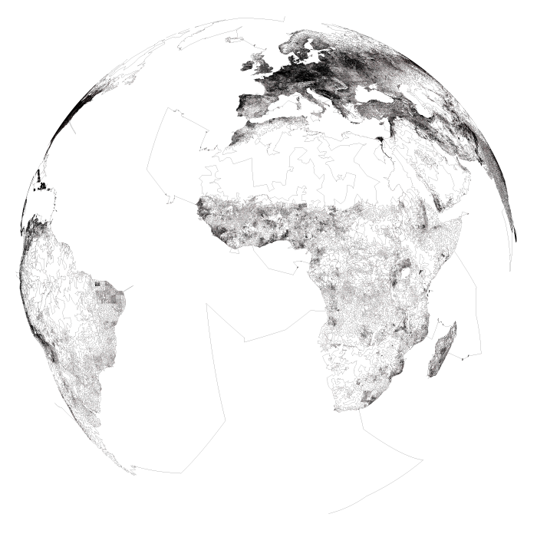

Slide 7
Implementation
Brute-force
Written in javascript
Integrated with Google maps
Great until n > 10

